Slide 1
MM 225 – AI and Data Science Day 8: Random Variable : Continuous
Instructors: Hina Gokhale, MP Gururajan, N. Vishwanathan
13 August 2024

Slide 2

Continuous Random Variable
Let X be a continuous random variable. The Probability Density Function f(x) is defined such that
f(x) ≥ 0
$\int_{−∞}^{∞}{f\left(x\right)dx=1}$
$P\left[a≤X≤b\right]= \int_{a}^{b}{f\left(x\right)dx}$

Slide 3
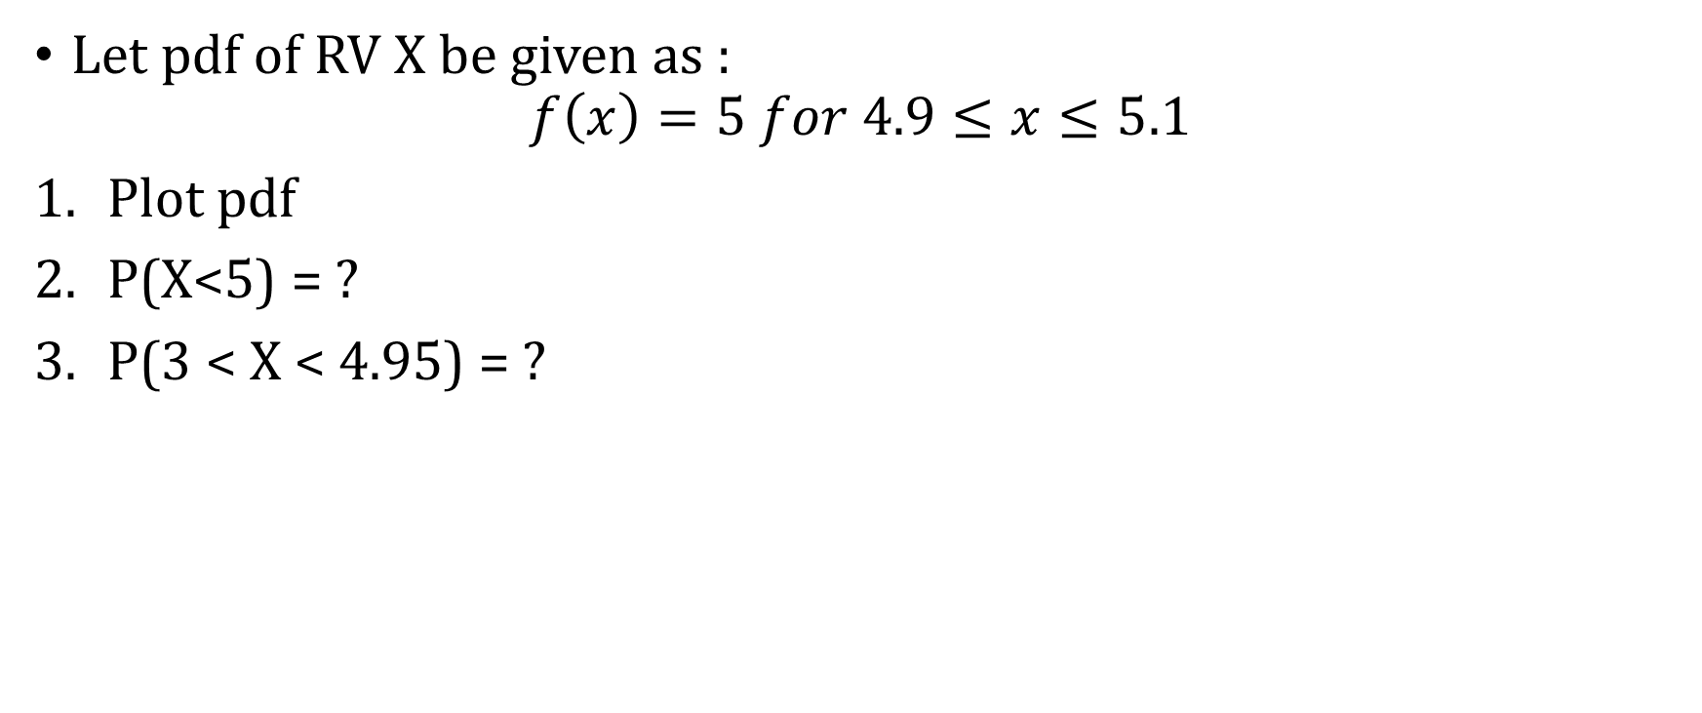
Example: pdf
Let pdf of RV X be given as :
$$f\left(x\right)=5 for 4.9≤x≤5.1$$
Plot pdf
P(X<5) = ?
P(3 < X < 4.95) = ?

Slide 4
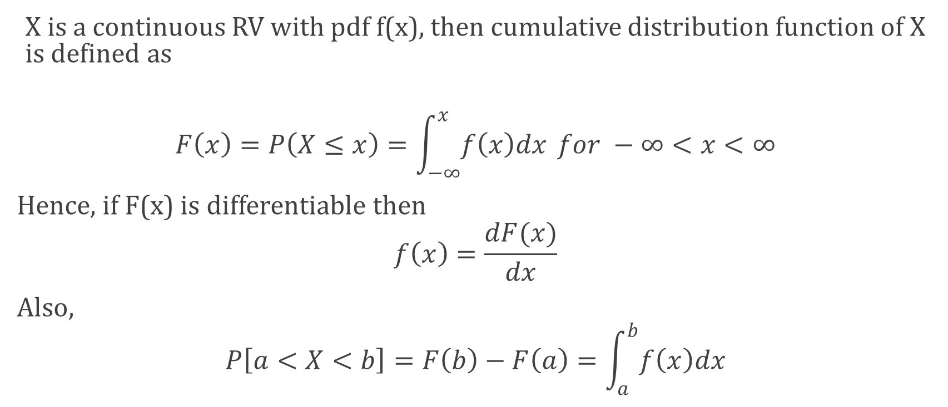
Cumulative Distribution Function : cdf
X is a continuous RV with pdf f(x), then cumulative distribution function of X is defined as
$$F\left(x\right)=P\left(X≤x\right)=\int_{−∞}^{x}{f\left(x\right)dx} for −∞<x<∞$$
Hence, if F(x) is differentiable then
$$f\left(x\right)=\frac{dF(x)}{dx}$$
Also,
$$P\left[a<X<b\right]=F\left(b\right)−F\left(a\right)=\int_{a}^{b}{f\left(x\right)dx}$$

Slide 5
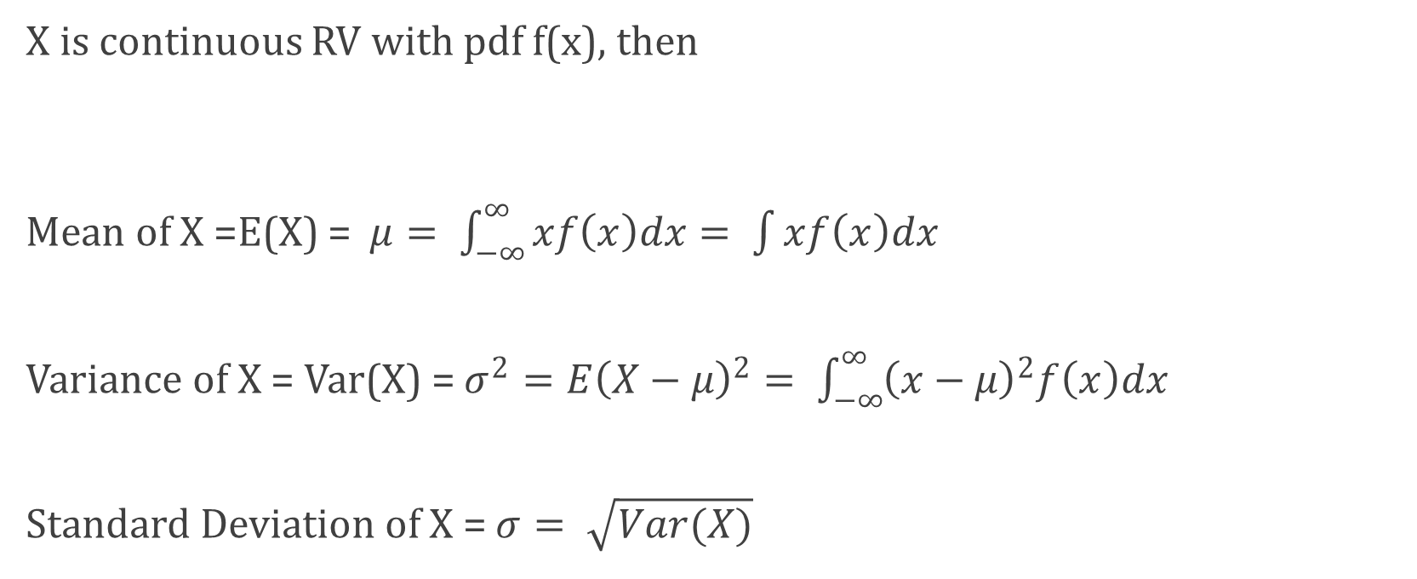
Mean and Variance of Continuous RV
X is continuous RV with pdf f(x), then
Mean of X =E(X) = $μ= \int_{−∞}^{∞}{xf\left(x\right)dx}= \int{xf\left(x\right)dx}$
Variance of X = Var(X) = $σ^{2}=E{\left(X−μ\right)}^{2}= \int_{−∞}^{∞}{{\left(x−μ\right)}^{2}f\left(x\right)dx}$
Standard Deviation of X = $σ= \sqrt{Var(X)}$

Slide 6
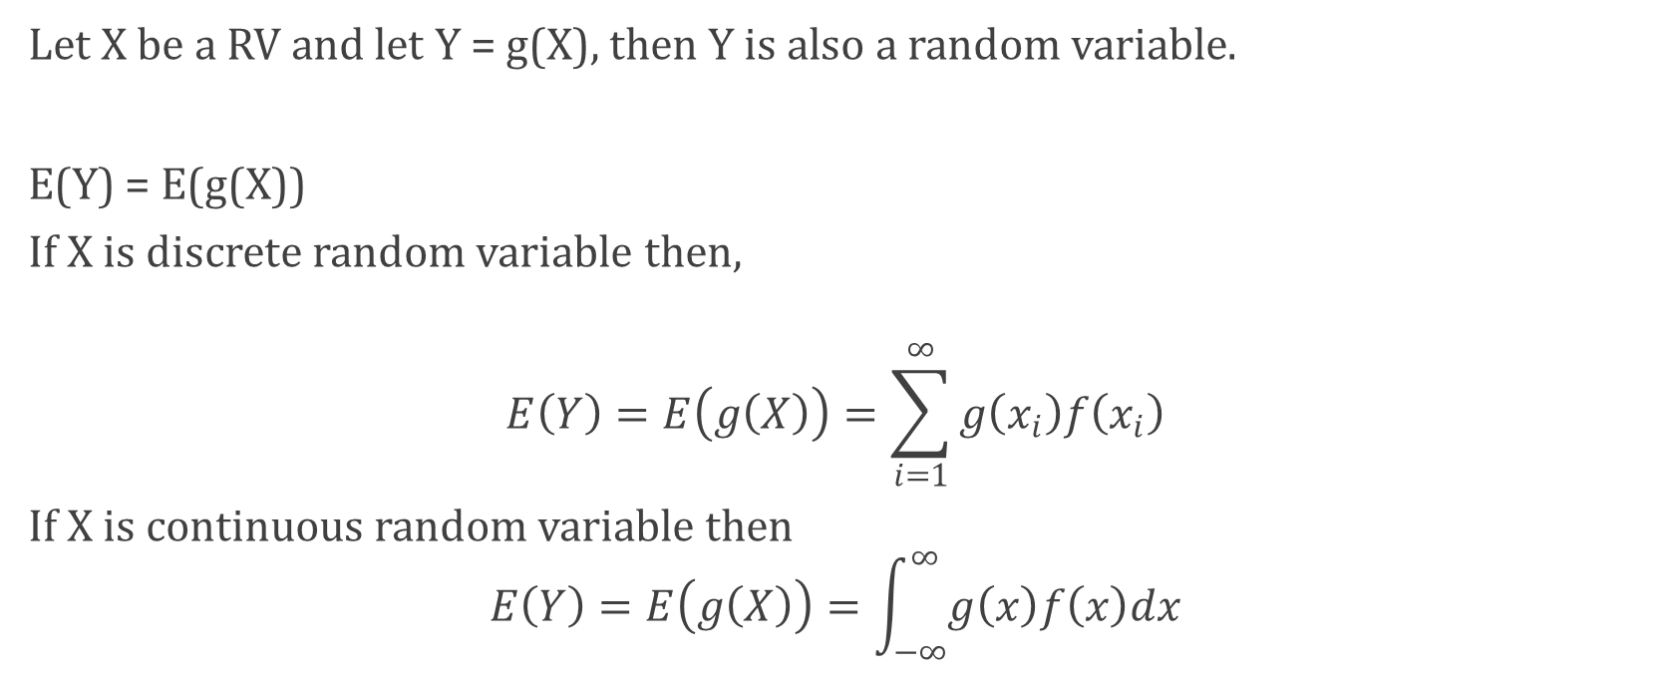
Function of random variable
Let X be a RV and let Y = g(X), then Y is also a random variable.
E(Y) = E(g(X))
If X is discrete random variable then,
$$E\left(Y\right)=E\left(g\left(X\right)\right)=\sum_{i=1}^{∞}{g\left(x_{i}\right)f\left(x_{i}\right)}$$
If X is continuous random variable then
$$E\left(Y\right)=E\left(g\left(X\right)\right)=\int_{−∞}^{∞}{g\left(x\right)f\left(x\right)dx}$$

Slide 7
Examples of useful continuous RV
Uniform distribution
Normal Distribution
Exponential Distribution : Poisson process
Distribution arising from Normal distribution

Slide 8
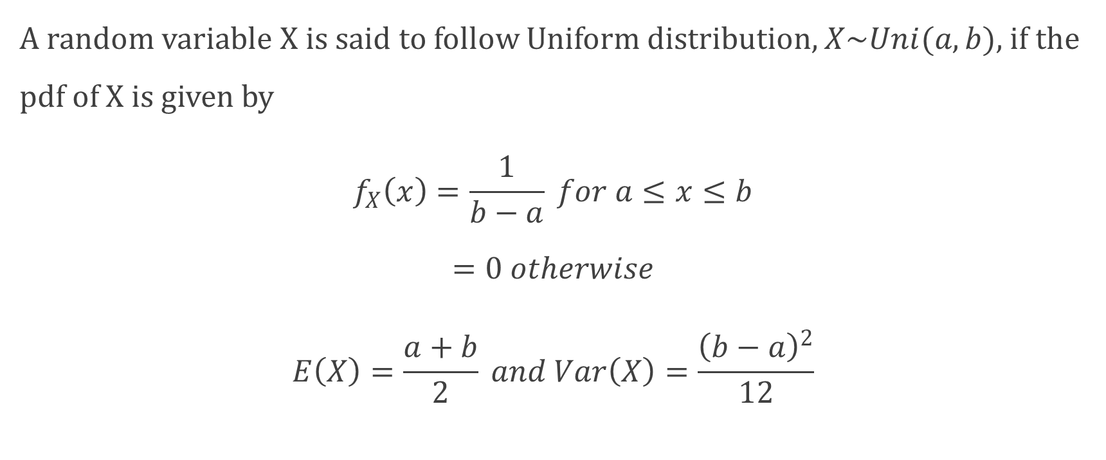
Uniform Distribution
A random variable X is said to follow Uniform distribution, $X\sim Uni(a, b)$, if the pdf of X is given by
$$f_{X}\left(x\right)=\frac{1}{b−a} for a≤x≤b$$
$$=0 otherwise$$
$$E\left(X\right)=\frac{a+b}{2} and Var\left(X\right)=\frac{{\left(b−a\right)}^{2}}{12}$$

Slide 9
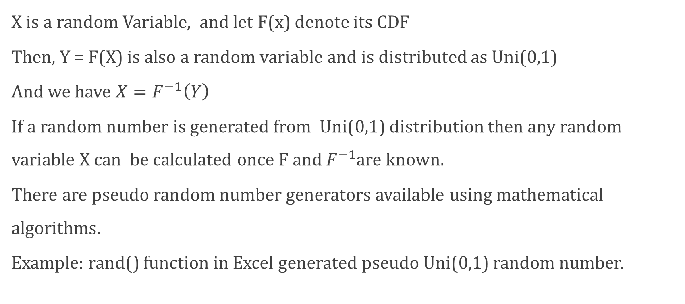
Uniform Distribution and Random Number Generation
X is a random Variable, and let F(x) denote its CDF
Then, Y = F(X) is also a random variable and is distributed as Uni(0,1)
And we have $X=F^{−1}\left(Y\right)$
If a random number is generated from Uni(0,1) distribution then any random variable X can be calculated once F and $F^{−1}$are known.
There are pseudo random number generators available using mathematical algorithms.
Example: rand() function in Excel generated pseudo Uni(0,1) random number.

Slide 10
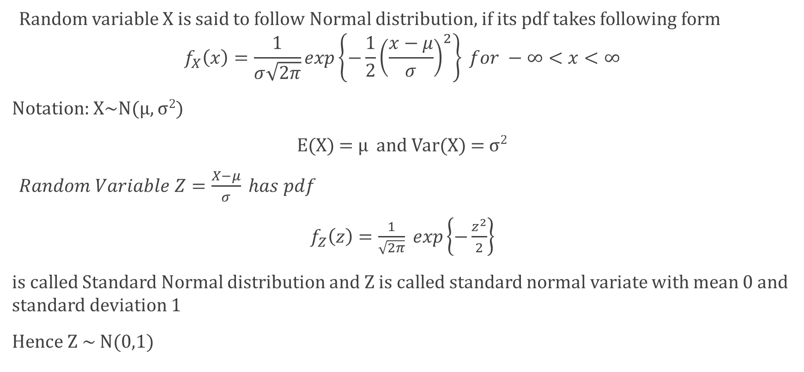
Normal Distribution / Gaussian Distribution
Random variable X is said to follow Normal distribution, if its pdf takes following form
$$f_{X}\left(x\right)=\frac{1}{σ\sqrt{2π}}exp\left\{−\frac{1}{2}{\left(\frac{x−μ}{σ}\right)}^{2}\right\} for −∞<x<∞$$
Notation: X~N(μ, σ²)
E(X) = μ and Var(X) = σ²
$Random Variable Z=\frac{X−μ}{σ} has pdf$
$f_{Z}\left(z\right)=\frac{1}{\sqrt{2π}} exp\left\{−\frac{z^{2}}{2}\right\}$
is called Standard Normal distribution and Z is called standard normal variate with mean 0 and standard deviation 1
Hence Z ~ N(0,1)

Slide 11
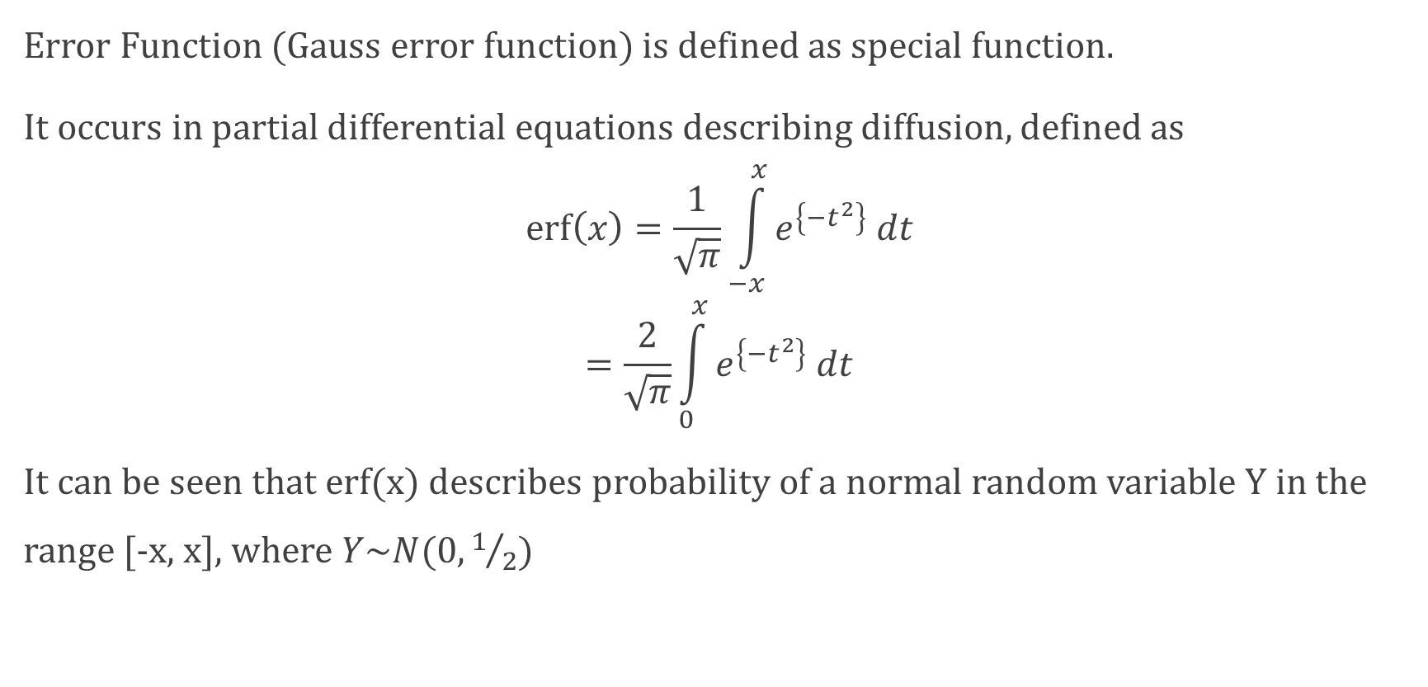
Error Function and Normal Distribution
Error Function (Gauss error function) is defined as special function.
It occurs in partial differential equations describing diffusion, defined as
$$\operatorname{erf}\left(x\right)=\frac{1}{\sqrt{π}}\int_{−x}^{x}{e^{\left\{{−t}^{2}\right\}} dt}$$
$$=\frac{2}{\sqrt{π}}\int_{0}^{x}{e^{\left\{{−t}^{2}\right\}} dt}$$
It can be seen that erf(x) describes probability of a normal random variable Y in the range [-x, x], where $Y\sim N(0, 1/2)$

Slide 12

Exponential Distribution
A random variable X is said to follow exponential distribution if its probability density function is
$f\left(x\right)=\left\{\begin{aligned}λe^{−λx} for x>0 \\ 0 Otherwise\end{aligned}\right.$
Notation: X~Exp(λ)
$$E\left(X\right)= 1/λ$$
$$Var\left(X\right)=1/{λ^{2}}$$

Slide 13
Lack of Memory
P[X > t₁ +t₂| X > t₁] = P[X > t₂] or equivalently
P[X < t₁ +t₂| X > t₁] = P[X < t₂]

Slide 14
Thank you….

